Slide 1
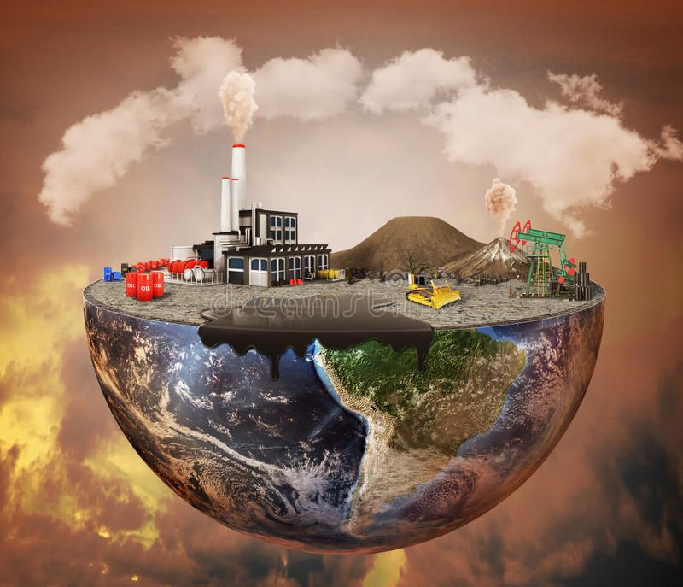
Pollution Definition
Pollution is the introduction of contaminants into the natural environment that cause adverse change. Pollution can take the form of any substance or energy. Pollutants, the components of pollution, can be either foreign substances/energies or naturally occurring contaminants.

Slide 2
Pollution Types
Air pollution
Water pollution
Soil pollution
Radioactive pollution
Noise pollution

Slide 3
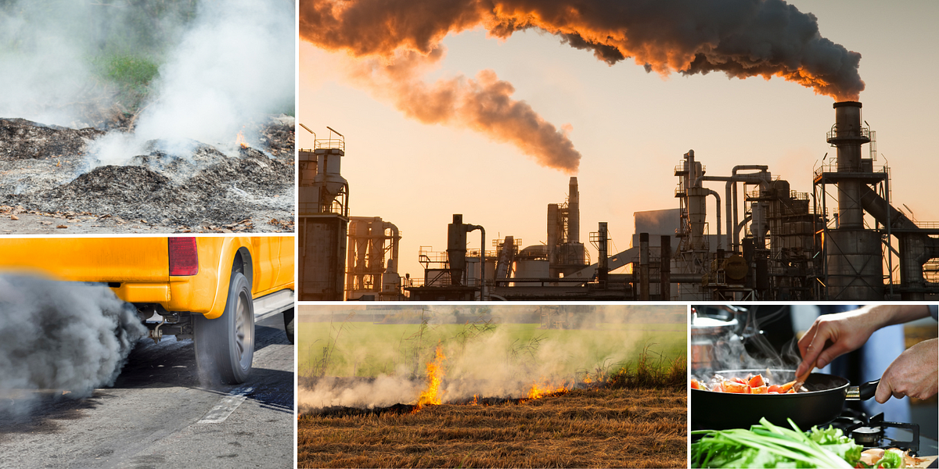
What is air pollution
Air pollution is the contamination of air due to the presence of substances called pollutants in the atmosphere that are harmful to the health of humans and other living beings, or cause damage to the climate or to materials.

Slide 4
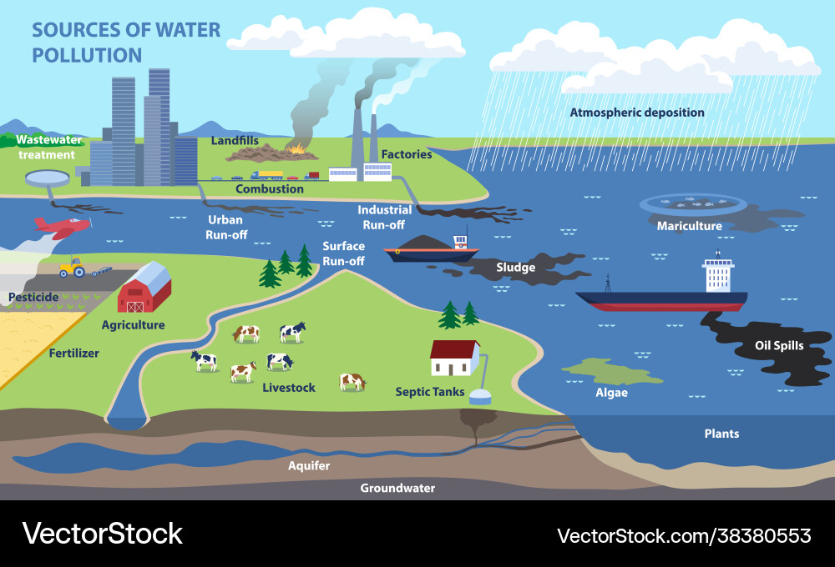
What is water pollution
Water pollution is the contamination of water bodies, with a negative impact on their uses. It is usually a result of human activities. Water bodies include lakes, rivers, oceans, aquifers, reservoirs and groundwater. Water pollution results when contaminants mix with these water bodies.

Slide 5
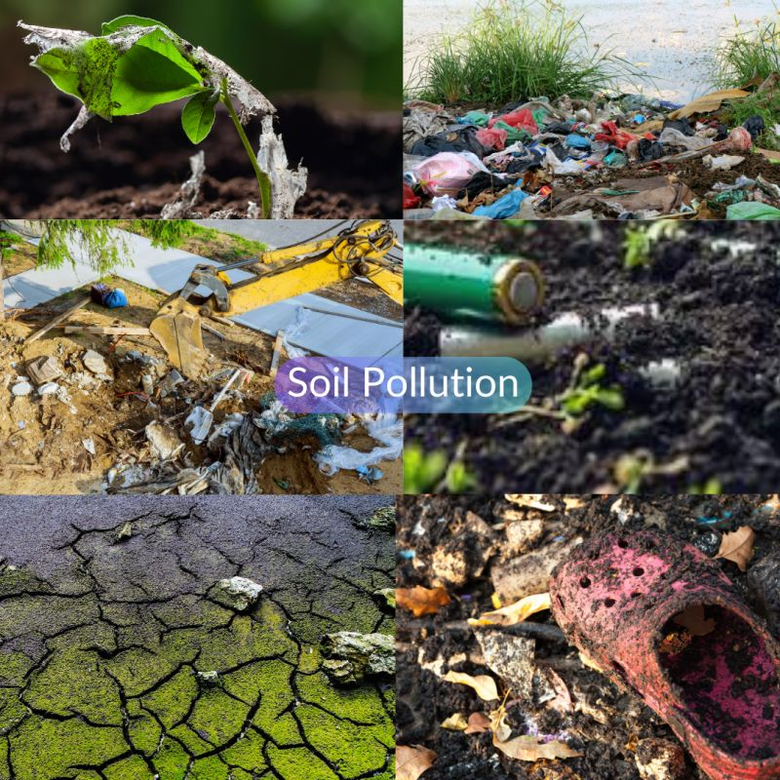
What is soil pollution
Soil contamination, soil pollution, or land pollution as a part of land degradation is caused by the presence of xenobiotic chemicals or other alteration in the natural soil environment. It is typically caused by industrial activity, agricultural chemicals or improper disposal of waste

Slide 6
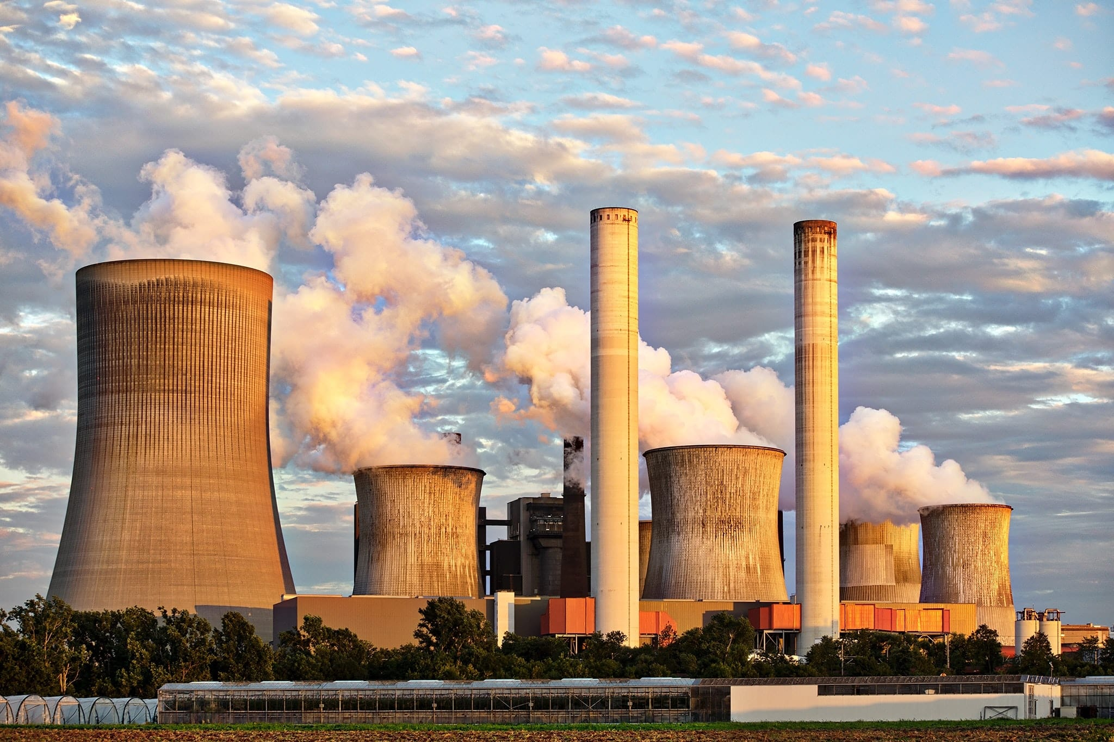
What is radioactive pollution
Radioactive contamination, also called radiological pollution, is the deposition of, or presence of radioactive substances on surfaces or within solids, liquids, or gases, where their presence is unintended or undesirable.

Slide 7
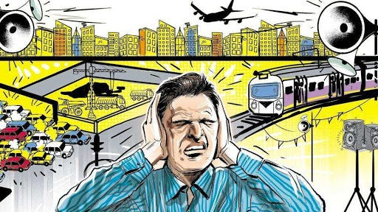
What is noise pollution
Noise pollution, or sound pollution, is the propagation of noise or sound with ranging impacts on the activity of human or animal life, most of which are harmful to a degree. The source of outdoor noise worldwide is mainly caused by machines, transport and propagation systems.

Slide 8
How to protect pollution
On Days when High Particle Levels are Expected, Take these Extra Steps to Reduce Pollution:
Reduce the number of trips you take in your car.
Reduce or eliminate fireplace and wood stove use.
Avoid burning leaves, trash, and other materials.
Avoid using gas-powered lawn and garden equipment.

